Slide 1
Digital portfolio
STUDENT NAME: Sakthi .S REGISTER NO AND NMID: asbruaj2428c0210
DEPARTMENT: BSC COLLEGE: A.V.P COLLEGE OF ARTS AND SCIENCE / Bharathiar university

Slide 2
Project Title
My Skill Development Portfolio

Slide 3
Problem Statement
Students often lack a professional and structured way to present their skills and certifications Traditional resumes are static and don’t highlight growth or future goals effectively. Recruiters and educators find it difficult to evaluate practical skills from paper-based resumes A need exists for an interactive, skill-focused digital portfolio to showcase lifelong learning.

Slide 4
Project Overview
This project is a web-based skill development portfolio that allows students to highlight their learning journey, certifications, projects, and future goals. It was designed using HTML, CSS, and JavaScript on CodePen.io, ensuring a responsive and visually appealing presentation.

Slide 5
End Users
Students – to build and maintain their skill-based portfolios Recruiters & Companies – to evaluate technical and soft skills during placements Faculty & Mentors – to guide students on progress and skill gaps Higher Education Institutions – for admissions and scholarships evaluation

Slide 6
Tools and Technologies
Frontend: HTML, CSS, JavaScript Platform: CodePen.i Version Control: GitHub Responsive Design: CSS Flexbox, Media Queries

Slide 7
Portfolio Design and Layout
Header Section: Title & tagline (Lifelong Learner | Tech Explorer | Problem Solver) Navigation Bar: About, Skills, Certifications, Projects, Future Goals, Contact About Section: Short bio & introduction Skills Section: List of technical and soft skills Certifications Section: Achievements and online course completions Projects Section: Academic & personal projects Future Goals Section: Career aspirations and learning roadmap Contact Section: Social media links, email, phone

Slide 8
Features and Functionality
Modern, clean responsive UI Sections for About, Skills, Certifications, Projects, Future Goals, and Contact Interactive and visually engaging design Easy to update with new skills and certifications Shareable online link for recruiters and institutions

Slide 9
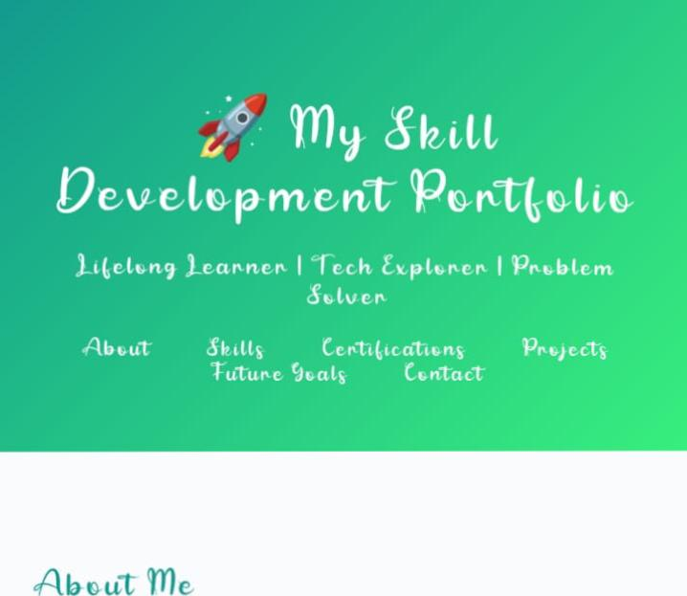
Results and Screenshots
A fully functional Skill Development Portfolio Website hosted on CodePen. Helps students present themselves beyond a resume. Screenshots highlight each section: Skills, Certifications, Projects, and Goals.

Slide 10
Conclusion
The project demonstrates how a Skill Development Portfolio can empower students to track and showcase their learning journey. It bridges the gap between resumes and real-world capabilities, offering an effective tool for placements, career building, and higher studies.

